Slide 1

DriverPass
System Analysis
[Your Name]
Notes:
[No speaker notes required for this slide.]

Slide 2
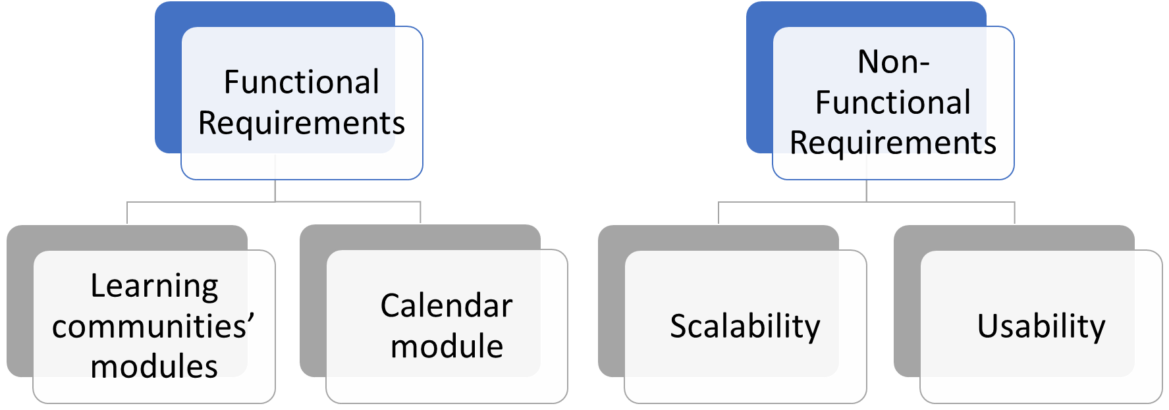
System Requirements
Notes:
Learning communities’ modules
Learning communities will create a environment where users are able to communicate with peers who are learning the same materials as them. This would be the internet equivalent of going to a friend’s house to work on a project together. Learning communities allow participation to happen between users and help motivate the self teaching process.
Calendar module
This calendar module will be used to book behind the wheel sessions by students filling out a calendar timeslot. This method makes behind the wheel classes flexible for the students. Instructors will also use this calendar for their availability so that their schedules are also flexible. An administrator will be able to oversee and set minimum requirements for instructors to book. For an example, instructors must work at least one weekend a month, or they must schedule 15 hours a week to behind the wheel.
Scalability
As DriverPass becomes a more popular way to learn in the driver's education community, it will require more memory and storage allocation for the server. Being that we are using clode base resources, we can purchase more data allocation to support the incoming users
Usability
The simplicity that students receive with DriversPass is industry leading. Students will now be able to learn from home with a device that has access to a internet browser. This allows for users to access the platform 24 hours a day. With our LMS, the users will be experiencing an outstanding new way of learning.

Slide 3
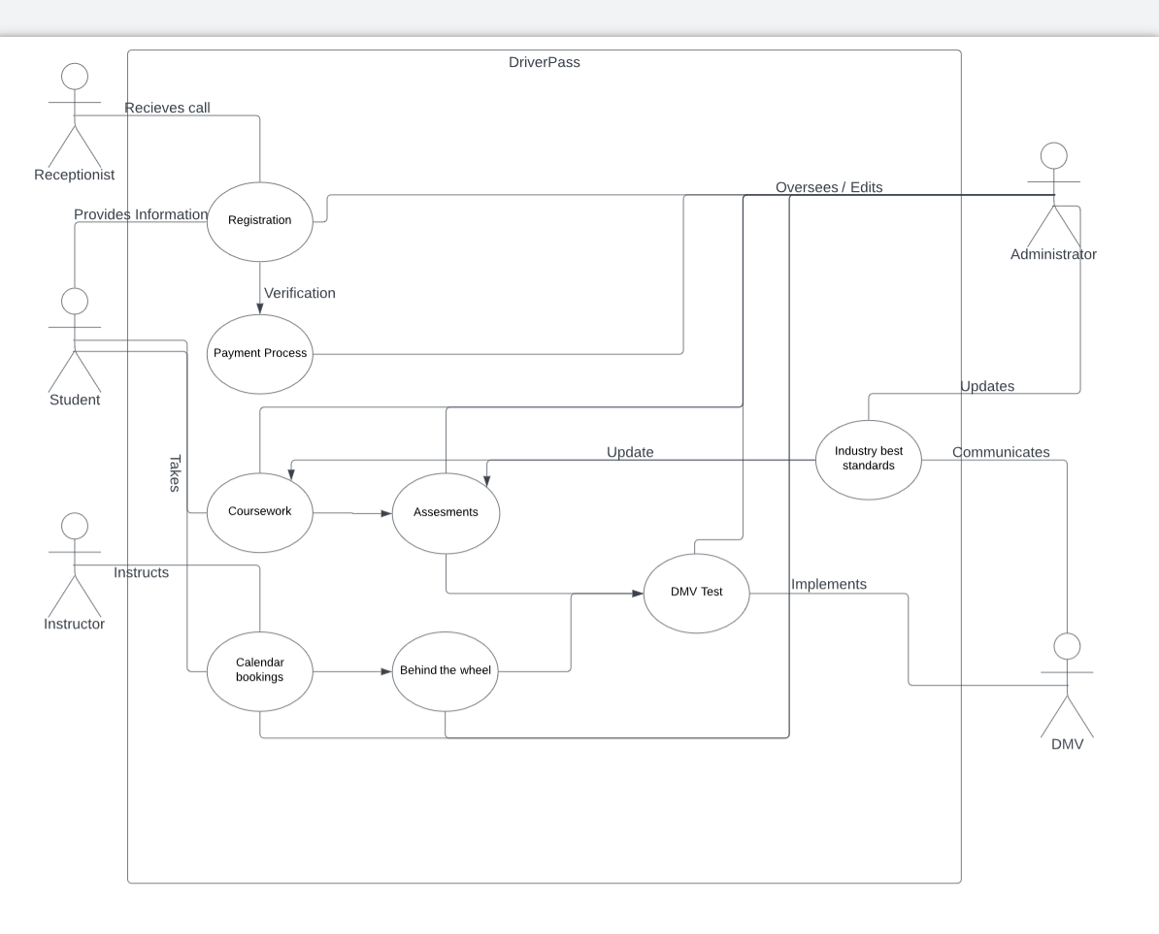
Use Case Diagram
Notes:
This use case diagram shows how people interact with one another to make DriverPass work.
First the student registers via phone call with the receptionist, the receptionist will then take a payment method and verify that it goes through.
The student will then have access to view courses, take assessments and book by the calendar.
Once the student books a session with the calendar, the instructor will receive a notification that they have a session and give them the reserved slot information.
The student then preforms the behind the wheel and the instructor takes notes on the process.
Once the student takes all the required behind the wheel sessions and assessments, they then can proceed to the DMV to take a Test.
After the test is completed the user gets their drivers license and no longer needs to use DriverPass.
An administrator oversees all the processes in DriverPass and edits them based on the DMV’s industry best standards that are communicated to the admins.

Slide 4
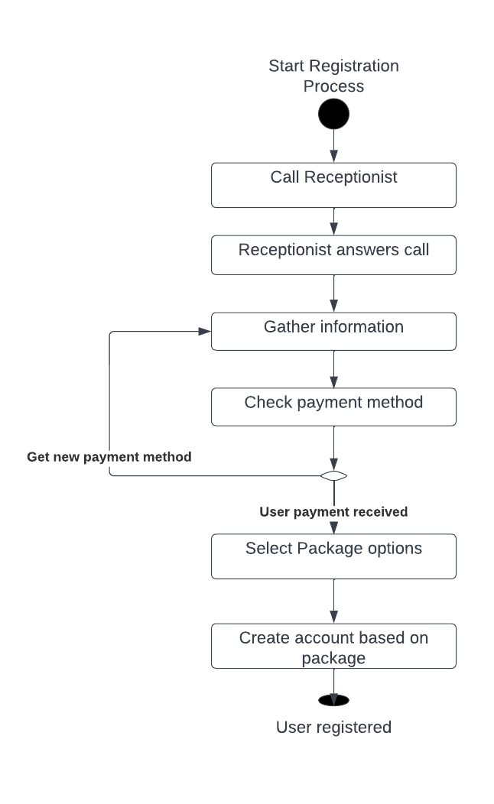
Activity
Diagram
Notes:
This Activity Diagram breaks down the registration process from start to finish.
As you can see, the user calls the receptionist and the receptionist answers the call.
After this is done the Receptionist will gather information such as name, date of birth, and payment method.
The system will then check the payment method to see if it is valid.
If for whatever reason it is not valid, the receptionist will then gather a new payment method until the payment is validated.
Once this is completed, the user will then be able to select through package options on the website
Sessions and content will be displayed to the user based off of the package that they choose and the registration process ends.

Slide 5
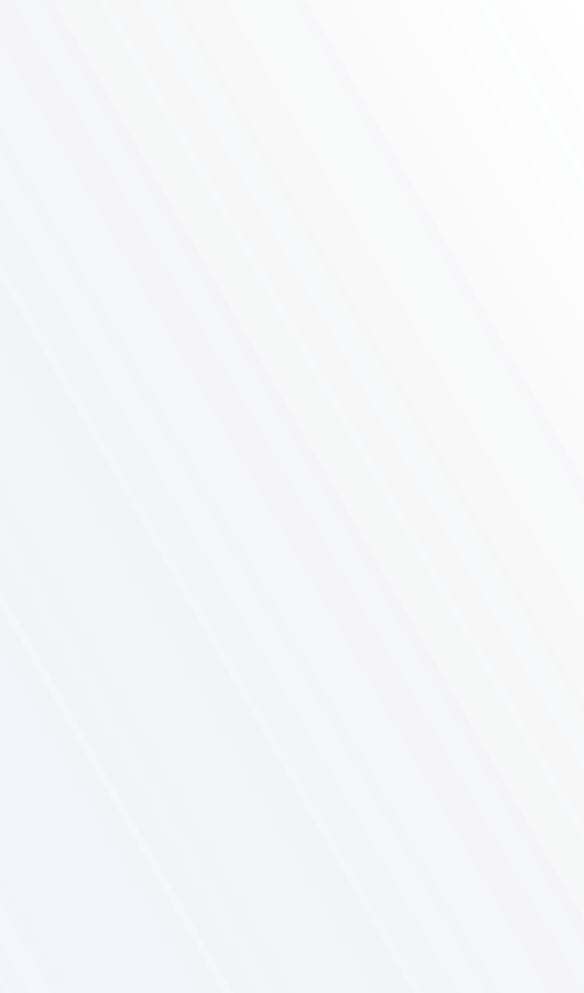

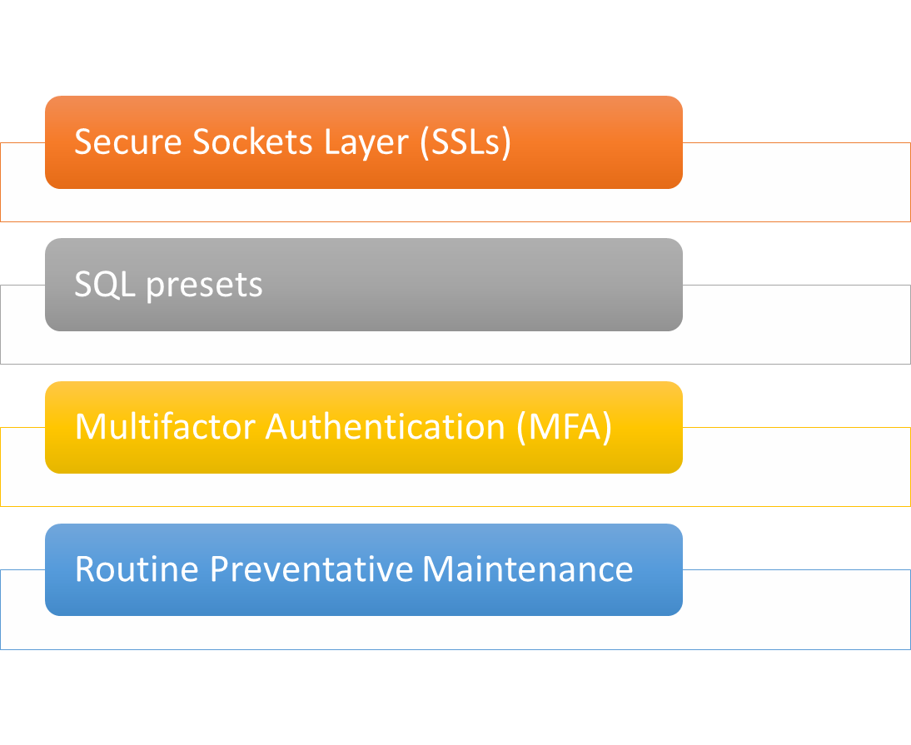


Security
Notes:
To protect users from hackers and malware database breaches, we will use Secure Sockets Layers (SSLs) these protect the user's information directly through the website. Passwords will show up to hackers as a random generated code such as “ADHF#)(RE23” instead of “1234password.”
We will use SQL presets for our database, this protects us from hackers trying to interact and get information from our database. This ensures that users private information is protected such as methods of payment.
Multifactor Authentication creates a code that users can receive in a variety of ways including email, text, phone call, or application. This code will act as a second layer of verification for the user to login and verify that it is them. This protects DriverPass from any unwanted information.
Routine Preventative Maintenance ensures that DriverPass stays up to date with industry standards and protects us against new methods of hacking. Routine Preventative maintenance will also fix any bugs or complications that the server might run into.

Slide 6
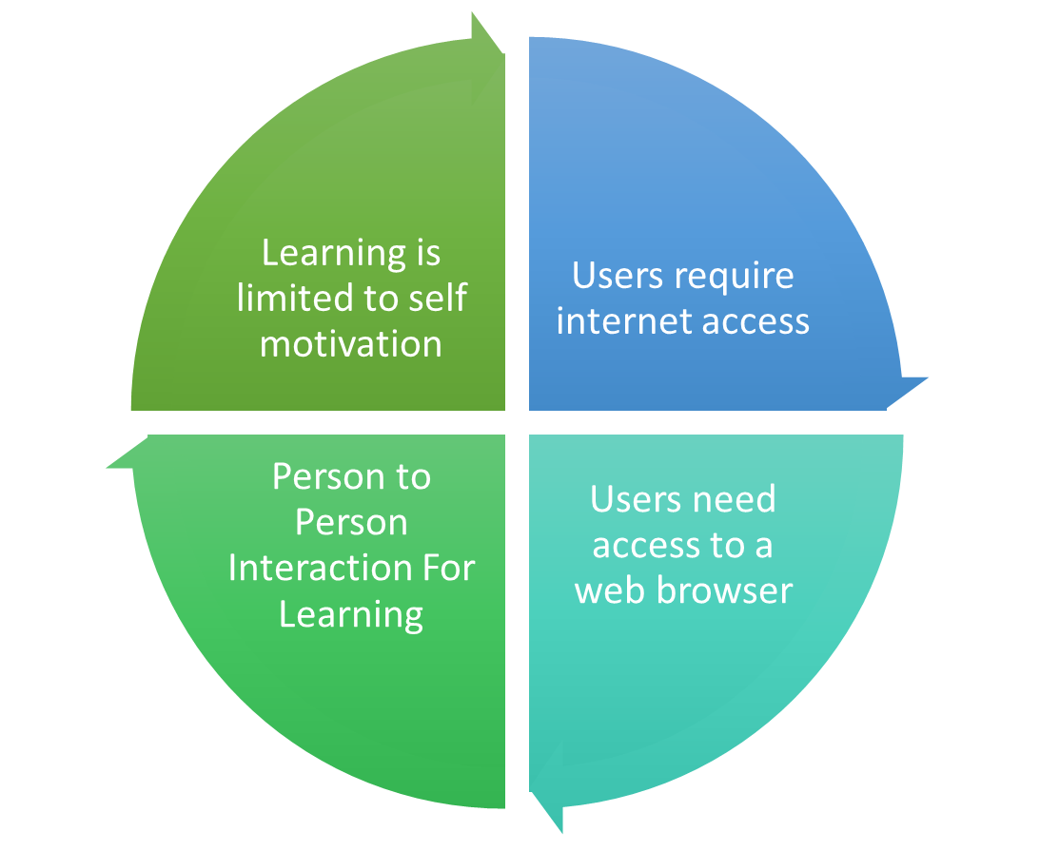
System Limitations
Notes:
Unfortunately, our system does have limits that we need to make aware of when we are designing DriversPass.
First, users are limited to their own motivation during learning. We have come up with the idea of using learning communities. This will keep the users more involved. If users stay involved in what they are learning they become more curious and would likely continue to learn on their own!
Another limitation that DriverPass has is that users must be able to access the internet to use effectively. To get past this, we can allow users to download files to preview content momentarily if they are anywhere where they cannot receive content.
Person to person Interaction is also limited, this causes a lack of effort for instructors to help students during coursework. However, during driving sessions the student will still be required to drive with a instructor in person to get a person to person learning experience.
Users must also be able to access a web browser. The good thing about this is that most devices now adays have access to a web browser. Users can go to the library, use a shared device, or go to their school to access DriverPass.

